Slide 1
01QP-19/02SUB-19: Reserve in the Pines Quadrant Plan & Subdivision Tentative Plat
City of La Pine
Planning Commission Deliberation/Decision
March 18, 2020

Slide 2
Applicable Review Criteria
City of La Pine Development Code
Article 3. Zoning Districts
Chapter 15.20 Residential Master Plan Zone
Chapter 15.22 Commercial and Mixed-Use Zones
Article 4. Overlay Zones
Chapter 15.30 Overlay Zones Generally
Chapter 15.32 Newberry Neighborhood Planning Area (NNPA) Overlay Zone
Article 5. Development Standards
Chapter 15.80 Development Standards, Generally
Chapter 15.88 Access and Circulation
Chapter 15.90 Public Facilities
Chapter 15.92 Additional Standards for Land Divisions
Chapter 15.94 Improvement Procedures and Guarantees
Article 7. Procedures
Chapter 15.204 Application Procedures
Article 9. Land Divisions
Chapter 15.402 General Provisions
Chapter 15.406 Subdivisions and Planned Unit Developments (PUD)
Chapter 15.418 Processing and Recording Procedures

Slide 3
Process Updates
Planning Commission Hearing, February 19, 2020
ODOT Requested Record Remain Open
ODOT Submitted Comments
Applicant Responded
Record is closed.

Slide 4
Tonight
Deliberation and Decision
No new information can be presented.
Applicant will not be provided time for testimony.
Staff can offer clarifying answers to questions, but no new info.
Ex Parte Contacts – Does anyone have anything to declare? Does anyone wish to challenge any of the commissioners on ex parte contacts?

Slide 5
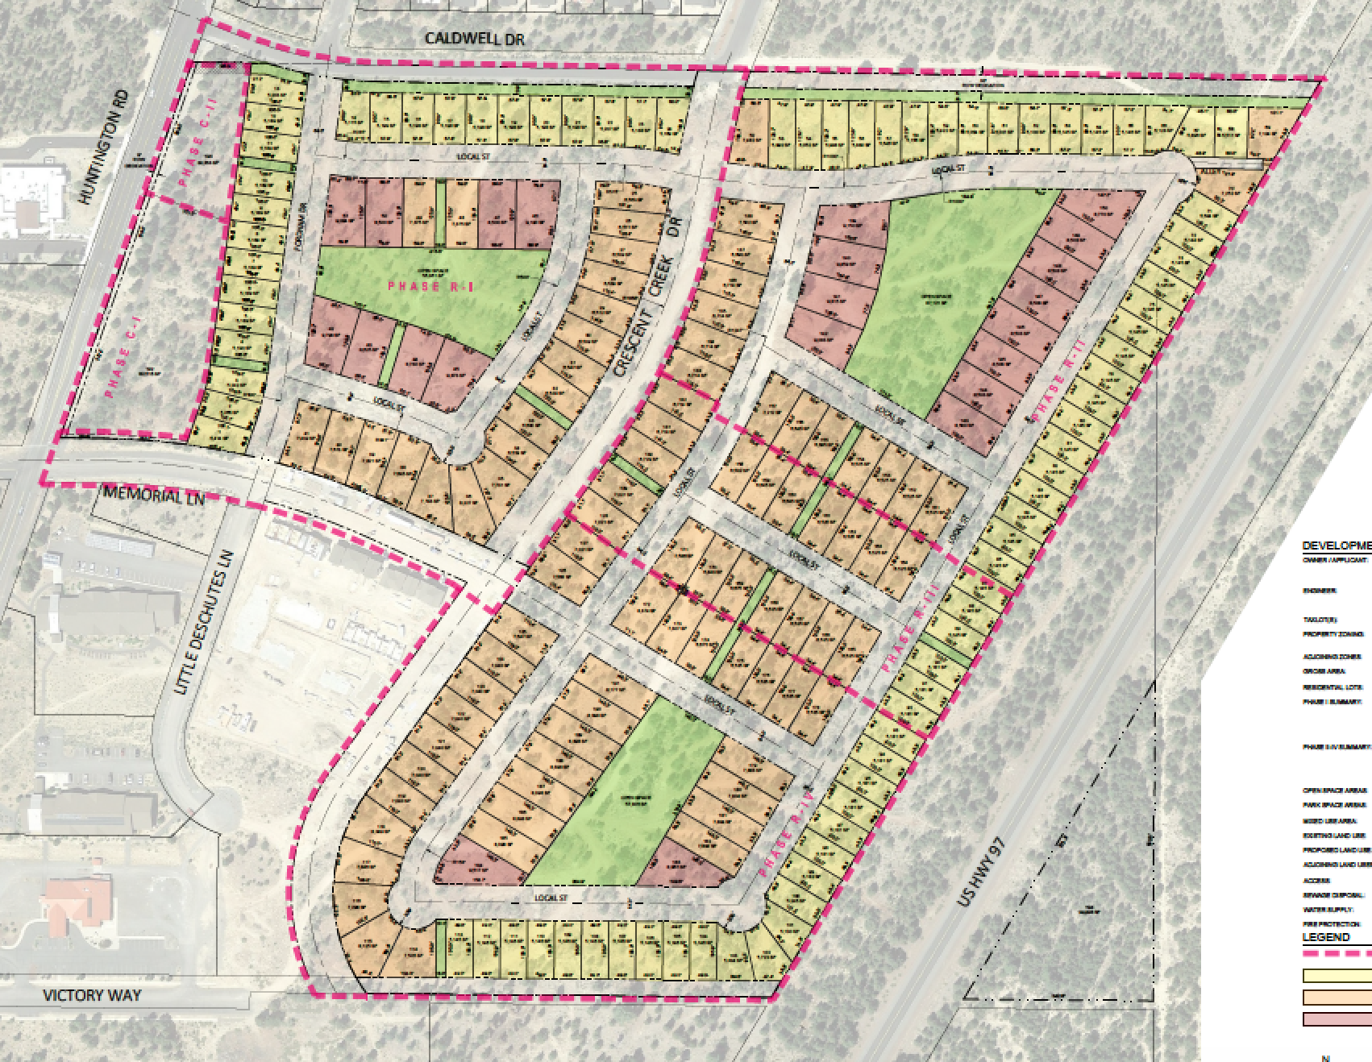
Proposal
Tentative Plat for 194-lot subdivision
4 residential phases, 2 commercial phases
Lot sizes: 5,115 sf to 9,793 sf
Zoned residential master plan (RMP) and mixed use commercial (CMX)
Parks, Open Space

Slide 7
ODOT Comments
Recommends developer propose mitigation for impacts at US 97/Burgess.
IGA between City and ODOT required for proposed multi-use path.
ODOT Misc/Construction Permit required for work in right of way.
Drainage study shall be prepared if there is any impact to ODOT highway drainage.

Slide 8
Applicant Final Argument
Applicant to contribute $12,435 to US 97/Burgess intersection.
Per unit basis, at time of platting (phased).
Applicant supports conditions of staff report, with the exception of the extension of the easternmost roadway to Caldwell and Victory. Their final argument includes their reasoning.

Slide 9
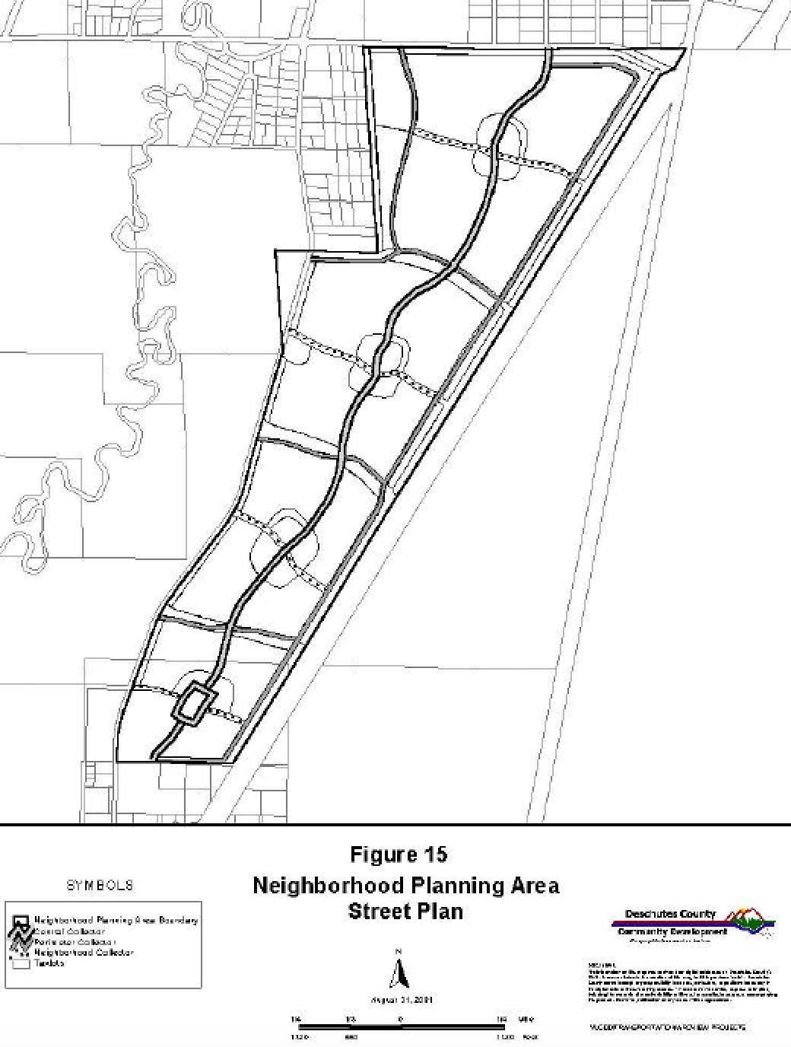
Extension north to Caldwell

Slide 10
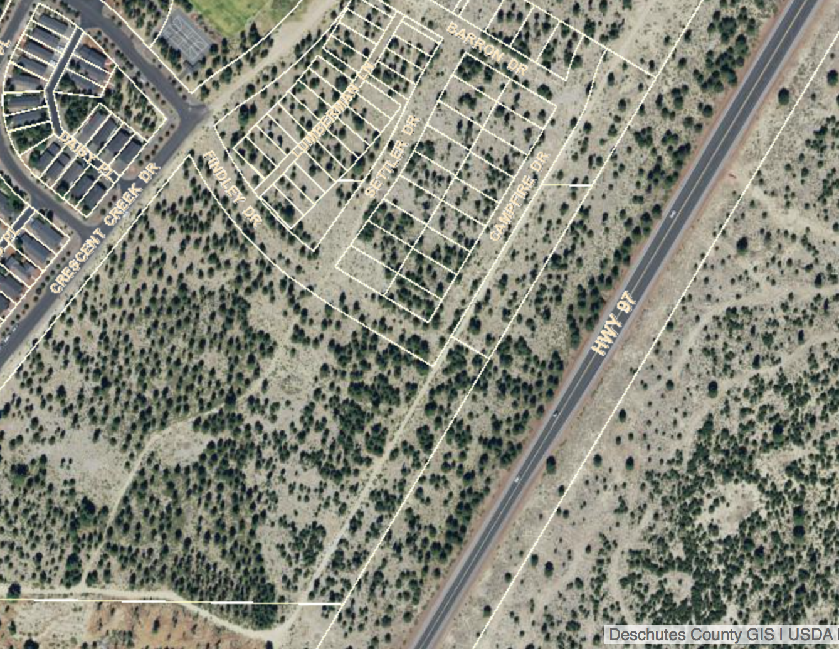
Extension north to Caldwell

Slide 11
Extension south to Victory

Slide 12
Extension south to Victory

Slide 13
Proposed Conditions
See end of staff report.
Proposed Additional Condition:
Applicant shall submit to ODOT a pro-rata contribution of $12,435 for impacts to the US 97/Burgess intersection. If permitted by ODOT, the contributions shall be submitted on a per unit basis payable at time of platting.
ODOT Misc/Construction Permit required for work in right of way.
Drainage study shall be prepared if there is any impact to ODOT highway drainage.

Slide 14
Final Steps
Commission – vote on proposed additional condition.
I move to add the following conditions of approval to the list of conditions for 01QP-19/02SUB-19:
- Applicant shall submit to ODOT a pro-rata contribution of $12,435 for impacts to the US 97/Burgess intersection. If permitted by ODOT, the contributions shall be submitted on a per unit basis payable at time of platting.
- ODOT Misc/Construction Permit required for work in right of way.
- Drainage study shall be prepared if there is any impact to ODOT highway drainage.
Commission – if desired, discuss the requirement for the connection of the easternmost roadway, connecting north to Caldwell and south to Victory (staff recommends both connections; Applicant contends they are not necessary).

Slide 15
Final Proposed Motion
I move to adopt the staff report findings and associated conditions of approval, as amended, and to approve 01QP-19 and 02SUB-19, the Reserve in the Pines quadrant plan and subdivision applications.

