Slide 1
01SUB-20: Reserve in the Pines Quadrant Plan & Subdivision Tentative Plat
City of La Pine
Planning Commission Hearing
February 19, 2020

Slide 2
Applicable Review Criteria
City of La Pine Development Code
Article 3. Zoning Districts
Chapter 15.20 Residential Master Plan Zone
Chapter 15.22 Commercial and Mixed-Use Zones
Article 4. Overlay Zones
Chapter 15.30 Overlay Zones Generally
Chapter 15.32 Newberry Neighborhood Planning Area (NNPA) Overlay Zone
Article 5. Development Standards
Chapter 15.80 Development Standards, Generally
Chapter 15.88 Access and Circulation
Chapter 15.90 Public Facilities
Chapter 15.92 Additional Standards for Land Divisions
Chapter 15.94 Improvement Procedures and Guarantees
Article 7. Procedures
Chapter 15.204 Application Procedures
Article 9. Land Divisions
Chapter 15.402 General Provisions
Chapter 15.406 Subdivisions and Planned Unit Developments (PUD)
Chapter 15.418 Processing and Recording Procedures

Slide 3
Process/Notices
Public Notice
Mailed to property owners within 250’, Planning Commission and City Council
Newspapers
Website
Regular locations around town
Planning Commission Hearing, February 19, 2020
Next Steps after Approval:
Meet conditions of approval (timelines vary)
Construction plans to be submitted to City & County for review
Pre-construction meeting with City
Construction or bonding of public improvements
Filing of Final Plat
Building Permit reviews

Slide 4
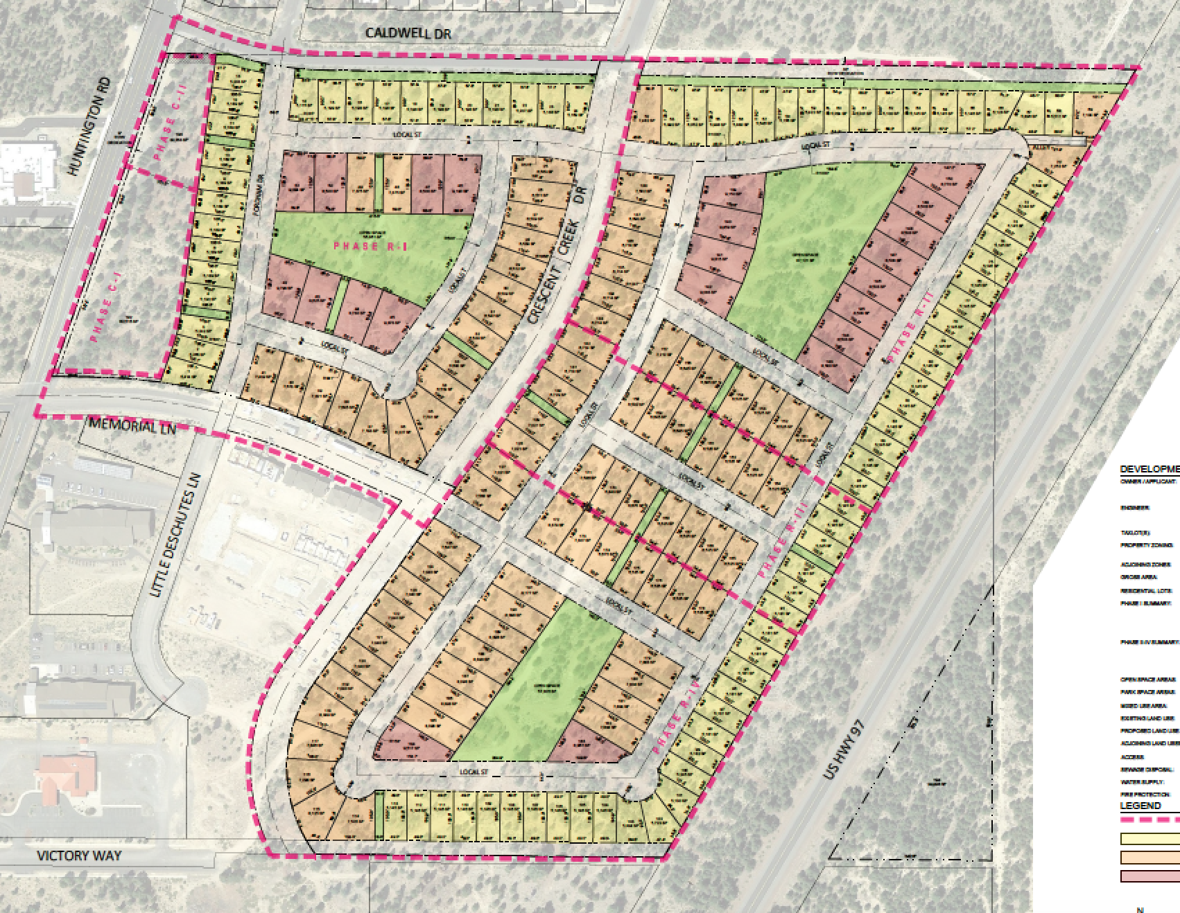
Proposal
Tentative Plat for 192-lot subdivision
4 residential phases, 2 commercial phases
Lot sizes: 5,115 sf to 9,793 sf
Zoned residential master plan (RMP) and mixed use commercial (CMX)
Parks, Open Space

Slide 6
Water
Public Works confirmed water capacity.
Final construction plans to be submitted to City for review and approval.

Slide 7
Sewer
Per City Engineer, wet well at Newberry Pump Station will be at capacity. Developer shall construct new wet well prior to final plat approval of 2nd residential phase.
Septic tank siting to be approved during building permit review.
Final construction plans to be submitted to City for review and approval.

Slide 8
Transportation
Proposal includes extension of Crescent Creek Drive, Memorial Lane (as a local street).
Conditions require extension of Victory Way, Caldwell Drive.
Conditions also require extension of easternmost north-south street to Victory Way and Caldwell Drive.
Conditions include construction of southbound left turn lane at Huntington/Memorial.

Slide 9
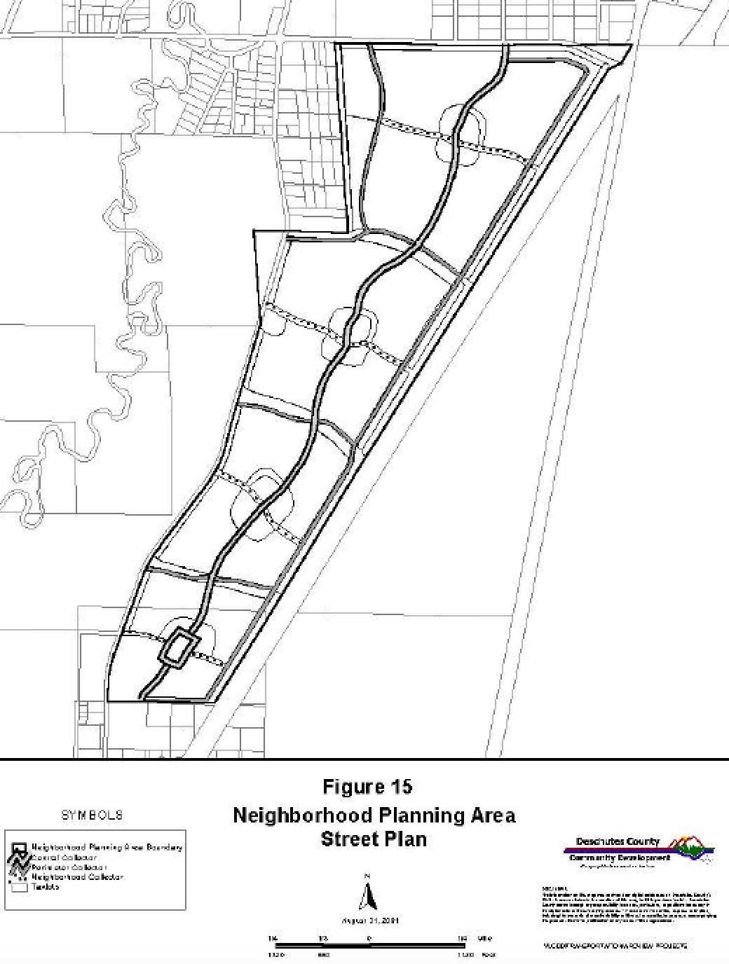
Extension north to Caldwell

Slide 10
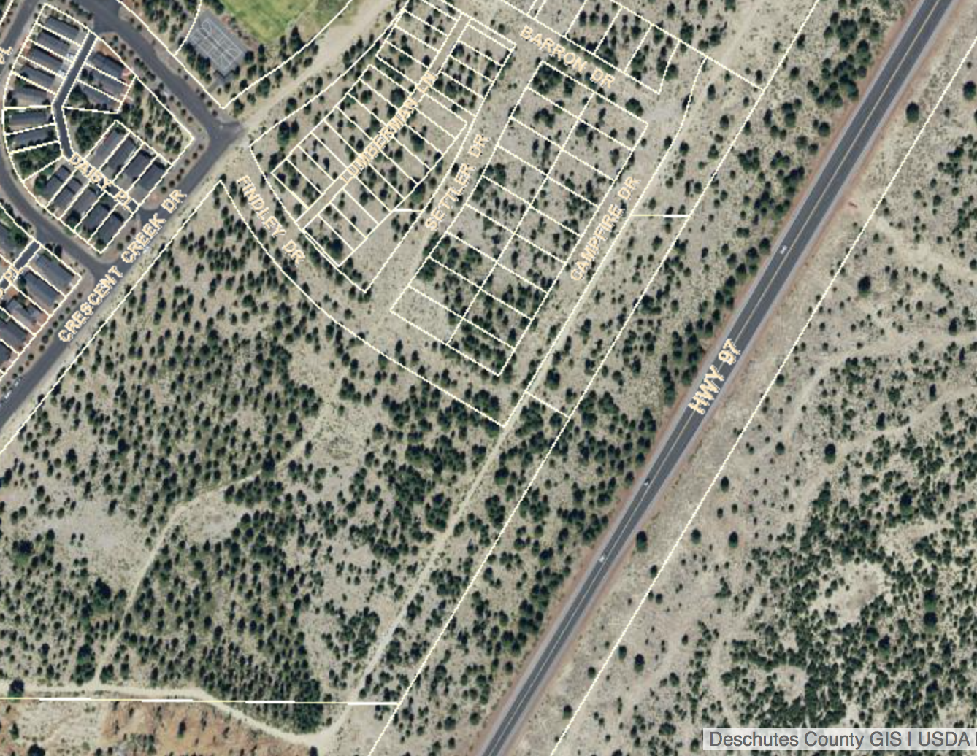
Extension north to Caldwell

Slide 11
Extension south to Victory

Slide 12
Extension south to Victory

Slide 13
Proposed Conditions
See end of staff report.
Some conditions are by phase.

Slide 14
Open Record Requested
ODOT has requested (2/19/20) that the record remain open.
LPDC requires that when left open, it be for a minimum of 14 days (7 days open, 7 days rebuttal).
21 days also an option (7 days open, 7 days applicant rebuttal, 7 days closing argument if desired by applicant)

