Slide 1
01SUB-19: Evans Way Subdivision Tentative Plat 02VA-19: Setback Variances
City of La Pine
Planning Commission Hearing
December 3, 2019

Slide 2
Applicable Review Criteria
City of La Pine Development Code
Article 3. Zoning Districts
Chapter 15.18 Residential Zones
Article 5. Development Standards
Chapter 15.80 Development Standards, Generally
Chapter 15.88 Access and Circulation
Chapter 15.90 Public Facilities
Chapter 15.92 Additional Standards for Land Divisions
Chapter 15.94 Improvement Procedures and Guarantees
Article 7. Procedures
Chapter 15.204 Application Procedures
Article 9. Land Divisions
Chapter 15.402 General Provisions
Chapter 15.406 Subdivisions and Planned Unit Developments (PUD)
Chapter 15.414 Re-Platting and Boundary Line Adjustments
Chapter 15.418 Processing and Recording Procedures

Slide 3
Process/Notices
Public Notice
Mailed to property owners within 100’, Planning Commission and City Council
Newspapers
Website
Regular locations around town
Planning Commission Hearing, December 3, 2019
Next Steps:
Construction plans to be submitted to City & County for review
Pre-construction meeting with City
Construction or bonding of public improvements
Filing of Final Plat
Building Permit reviews

Slide 4
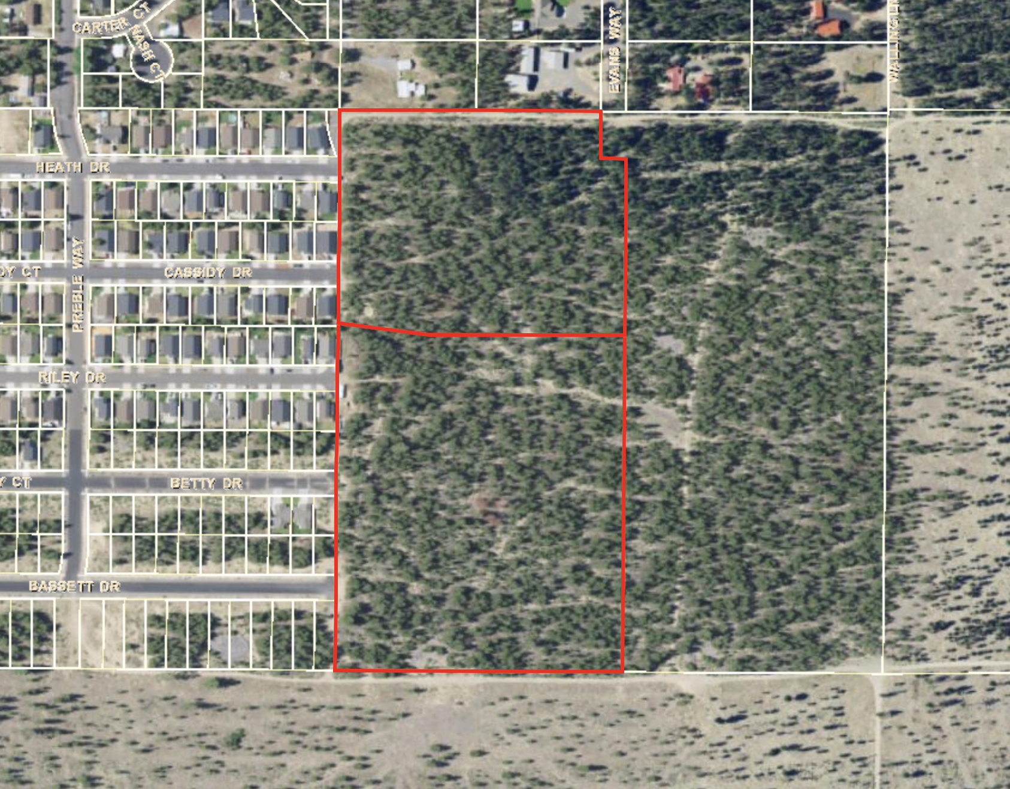
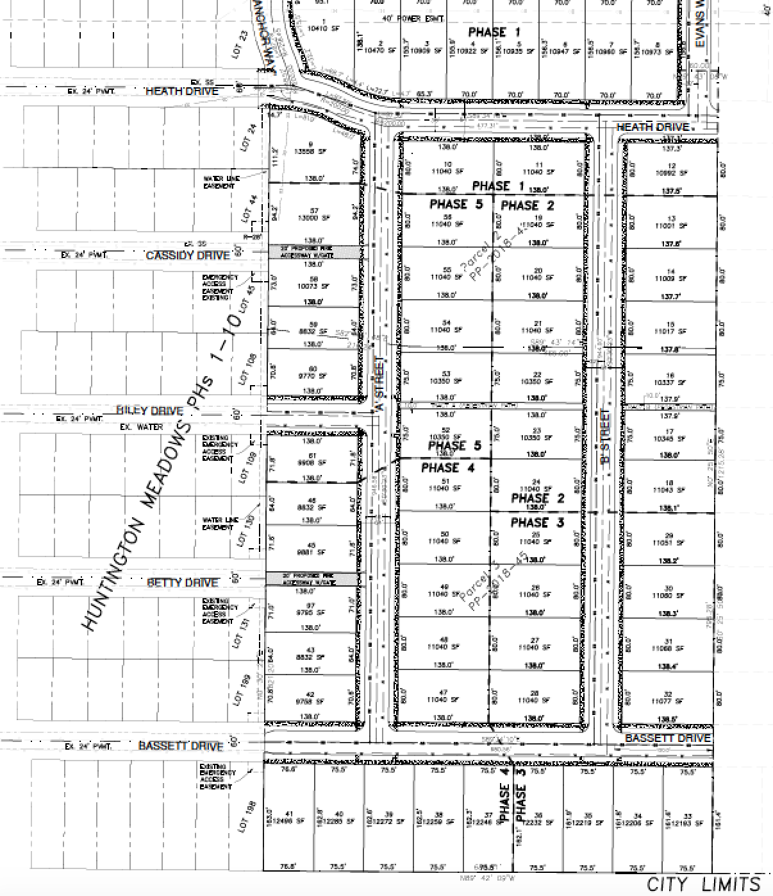
Proposal
Tentative Plat for 5-phased 61-lot Subdivision
Lot sizes: 8,832 sf to 13,558 sf
Zoned residential single family (RSF)
Accessory building development – storage, ADUs, etc.

Slide 6
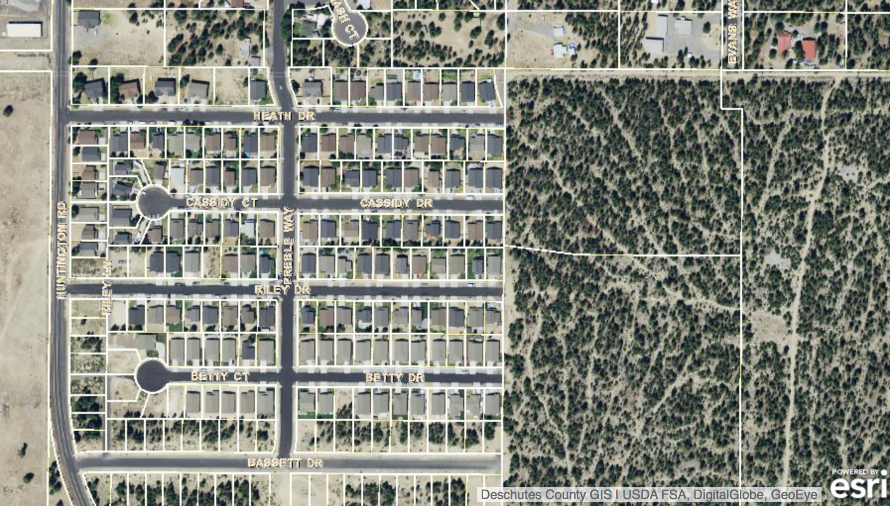
Block Length

Slide 7
Block Length

Slide 8
Water
Public Works confirmed water capacity.
Final construction plans to be submitted to City for review and approval.

Slide 9
Sewer
Per City Engineer, lift station serving area at capacity. Developer shall contribute $568.75 per equivalent dwelling unit (EDU) to a fund for replacement of lift station.
Septic tank siting to be approved during building permit review.
Final construction plans to be submitted to City for review and approval.

Slide 10
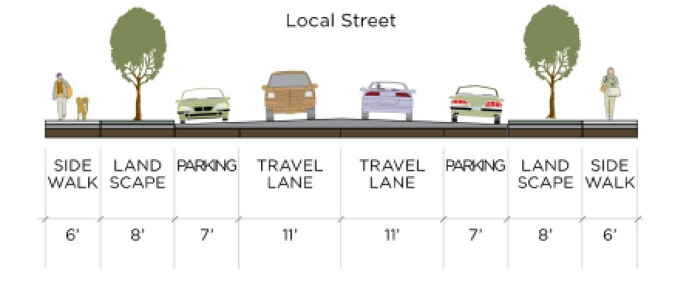
Transportation
Extension of Heath Drive, Bassett Drive, Riley Drive, Anchor Way, Evans Way; Construction of new A Street, B Street.
Local street construction = 64’ right of way, 6’ sidewalks both sides.
Applicant’s traffic report recommended contribution to streets: $518/lot.

Slide 11
Questions to PC
See beginning of staff report.
Are proposed extensions of Cassidy and Betty Drives acceptable? (Gated fire access alleys.)
Is the property to the south “developable”? Does A Street need to be extended to the south? Street or multi-use path?

Slide 12
Extensions of Betty & Cassidy Dr

Slide 13
Property to the South
635 feet

Slide 14
Proposed Conditions
See end of staff report.
Phasing:
Every phase shall have acceptable temporary fire turnarounds & associated easements, if necessary.
East-west multi-use path to be constructed prior to final plat of Phase 2.
All of Bassett Drive to be completed in Phase 3.
Sidewalks to be constructed on both sides of Anchor Way.
Street lights to be installed per City specs.

Slide 15
Variance Request
Side yard, rear yard, street-side yard
25% reduction throughout
15’ rear, street-side yard (code requires 20’)
7.5’ side yard (code requires 10’)
West side lots adjacent to Huntington Ave
side and street-side: 5’ minimum, 15’ combined

Slide 16
Variance Request

Slide 17
West Side Lots

Slide 18
Variance Options
Approve as requested
Deny
Consider each setback separately (side, rear, street-side)
Consider west side lots separately; Consider individual lots separately
Approve only for accessory buildings
Side yard: Both sides of building or only one?

Slide 19
Motion
Need separate motions for variance request and subdivision.

